Slide 1

CIC Scorecard Refresh for SIL
Presented by:
Data Science
January 2025

Slide 2
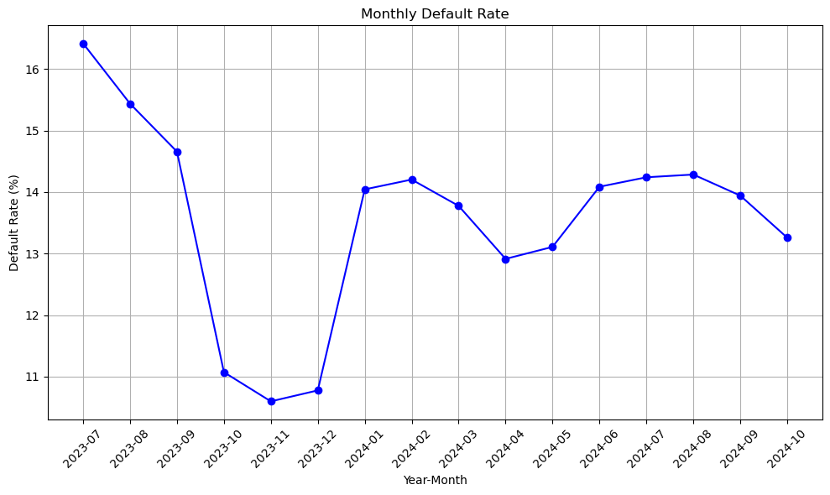
 | Loan Disbursement Date | # SIL Loans |  |  | # Bad (FSPD30) SIL Loans |  |  | FSPD30 rate
 |  | Overall | Mobile | Non Mobile | Overall | Mobile | Non Mobile | Overall | Mobile | Non Mobile
All Data Training – 90%,val – 10% | 01/07/2023 - 30/06/2024 | 31702 | 5576 | 26126 | 3604 | 1020 | 2584 | 0.1136 | 0.1829 | 0.0989
July | 01/07/2024 - 31/07/2024 | 8479 | 3015 | 5464 | 1181 | 583 | 598 | 0.1392 | 0.1933 | 0.1094
Aug | 01/08/2024 - 31/07/2024 | 11545 | 4546 | 6999 | 1600 | 830 | 770 | 0.1385 | 0.1825 | 0.1100
Sep | 01/09/2024 - 30/09/2024 | 11262 | 4578 | 6684 | 1517 | 848 | 669 | 0.1347 | 0.1852 | 0.1000
Oct | 01/10/2024 - 25/10/2024 | 7681 | 2965 | 4716 | 1009 | 551 | 458 | 0.1313 | 0.1858 | 0.09711
SIL Loan FSPD30 rate over the months

Slide 3
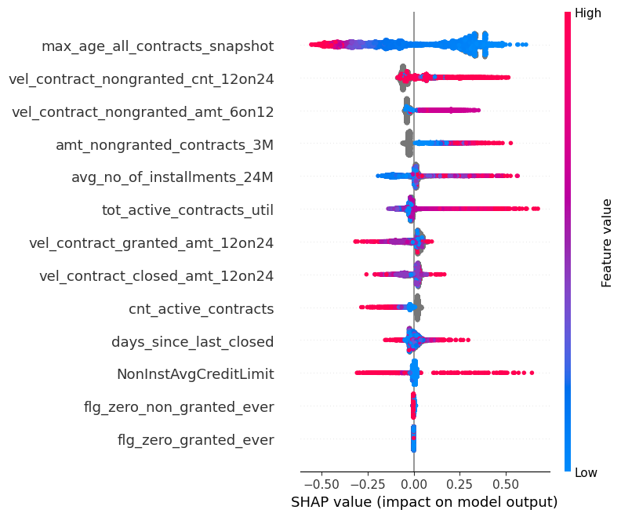
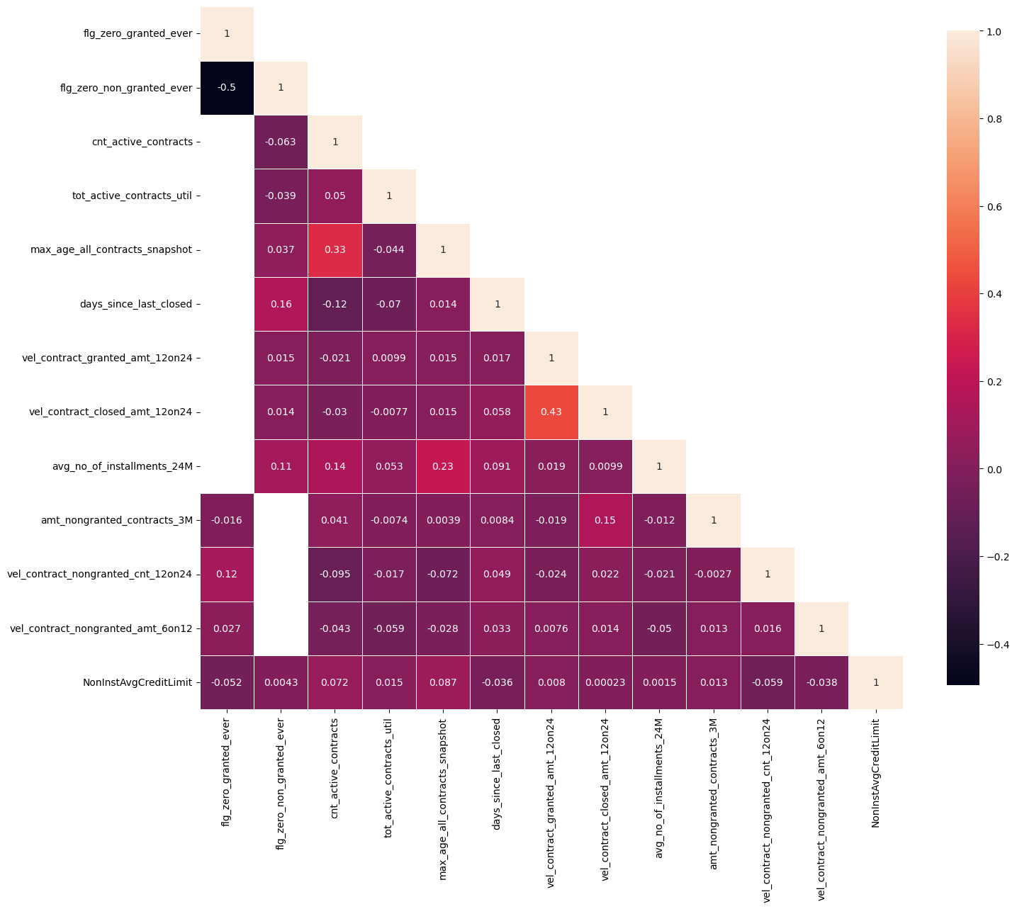
Top 13 Feature Performance

Slide 4
Top 13 Feature Description (1 of 2)
Feature Name | Feature Description
max_age_all_contracts_snapshot | For closed contracts age = closed date – start date, for active contracts age = run_date – start date. This feature broadly indicates the max loan tenor of active loans, hence higher tenor means lower risk
vel_contract_nongranted_cnt_12on24 | = count of contracts that granted in last 12 months / count of contracts that were granted in last 24 months. Usually if the velocity of granted loans increases in recent 12 months, it indicates higher risk
flg_zero_granted_ever | 1 means the customer does not have any granted contract in the CIC data
vel_contract_nongranted_amt_6on12 | = average amount of contracts that were denied in last 6 months / average amount of contracts that were denied in last 12 months. Usually if the velocity of denied loans amount increases in recent 6 months, it indicates higher risk
tot_active_contracts_util | Means the ratio of total outstanding amount of all currently active contracts/ total granted amount of all currently active contracts. This is a snapshot view feature
amt_nongranted_contracts_3M | Total amount from all denied loans in last 3 months
days_since_last_closed | Number of days since the user fully repaid his/her last loan or the last contract was marked as closed in CIC
avg_no_of_instalments_24M | Average number of instalments to be paid for all the contracts granted within last 24 months
vel_contract_granted_amt_12on24 | = average amount of contracts that were granted in last 12 months / average amount of contracts that were granted in last 24 months. Usually if the velocity of granted loans amount increases in recent 12 months, it indicates lower risk
NonInstAvgCreditLimit | Average Credit Limit from all Non-Instalment Loans at the time of querying the CIC. This is a Snapshot view feature. Please note the Non-Instalment loans mean the B2B loans like over-draft and Credit Line. They are NOT individual loans or Retails loans.

Slide 5
Top 13 Feature Description (2 of 2)
Feature Name | Feature Description
vel_contract_closed_amt_12on24 | = average amount of contracts that were closed in last 12 months / average amount of contracts that were closed in last 24 months. Usually if the velocity of closed loans amount increases in recent 12 months, it indicates lower risk
cnt_active_contracts | Total number of Active contracts at the time of querying the CIC data. This is a snapshot view feature
flg_zero_non_granted_ever | 1 means the user was never denied a loan, 0 means the user had at least one denied loan. Please note that here 1 does not always mean lower risk as the user may still be new in the system (thin file user)

Slide 6
Distribution of SIL Loans across various CIC Segments
 | Jul 23 - Jun 24 |  | Test (July) cnt |  |  | OOT (Aug) cnt |  |  | OOT (Sep) cnt |  |  | OOT (Oct) cnt
 | Train cnt | Val cnt | Overall | Mobile | Non Mobile | Overall | Mobile | Non Mobile | Overall | Mobile | Non Mobile | Overall | Mobile | Non Mobile
Model Trained on All the following Segments combined. Tested also on the 3 Segments Combined | 28531 | 3171 | 8479 | 3015 | 5464 | 11545 | 4546 | 6999 | 11262 | 4578 | 6684 | 7681 | 2965 | 4716
Segment 1: flag_matched = 1 AND Either of Granted or Non Granted contracts are available, If Granted Contracts available it will have at least one B2C Loans (Credit Cards, Instalment Loans) |  |  | 8209 | 2938 | 5271 | 11161 | 4407 | 6754 | 10820 | 4410 | 6410 | 7404 | 2864 | 4540
Segment 2: flag_matched = 1 AND Granted Contract of only irrelevant loan types (non-instalment loans, utility payment loans) available, irrespective of Non Granted Loans |  |  | 79 | 31 | 48 | 133 | 56 | 77 | 121 | 61 | 60 | 85 | 36 | 49
Segment 3: flag_matched = 1 AND NONE of Granted or Non Granted contracts are available |  |  | 191 | 46 | 145 | 251 | 83 | 168 | 321 | 107 | 214 | 192 | 65 | 85

Slide 7
 | Jul 23 - Jun 24 |  | Test (July) Gini |  |  | OOT (Aug) Gini |  |  | OOT (Sep) Gini |  |  | OOT (Oct) Gini
7 feature LogReg WOE Model in Production (December) –v1 | Train Gini | Val Gini | Overall | Mobile | Non Mobile | Overall | Mobile | Non Mobile | Overall | Mobile | Non Mobile | Overall | Mobile | Non Mobile
Model Trained on All the following Segments combined. Tested also on the 3 Segments Combined | 0.2555 | 0.2481 | 0.2202 | 0.1457 | 0.2602 | 0.2241 | 0.1681 | 0.2525 | 0.2542 | 0.2007 | 0.2767 | 0.2624 | 0.2294 | 0.2579
Segment 1: flag_matched = 1 AND Either of Granted or Non Granted contracts are available, If Granted Contracts available it will have at least one B2C Loans (Credit Cards, Instalment Loans) |  |  | 0.227 | 0.1452 | 0.2705 | 0.2337 | 0.1745 | 0.2622 | 0.2654 | 0.2092 | 0.2884 | 0.2705 | 0.2355 | 0.2668
Segment 2: flag_matched = 1 AND Granted Contract of only irrelevant loan types (non-instalment loans, utility payment loans) available, irrespective of Non Granted Loans |  |  | -0.0238 | 0.0652 | -0.0718 | -0.1806 | -0.1523 | -0.2881 | 0.0457 | 0.2193 | -0.1328 | -0.0276 | 0.004 | -0.2441
Segment 3: flag_matched = 1 AND NONE of Granted or Non Granted contracts are available |  |  | 0 | 0 | 0 | 0 | 0 | 0 | 0 | 0 | 0 | 0 | 0 | 0
 | Jul 23 - Jun 24 |  | Test (July) Gini |  |  | OOT (Aug) Gini |  |  | OOT (Sep) Gini |  |  | OOT (Oct) Gini
7 feature Refreshed Catboost - v1.1 | Train Gini | Val Gini | Overall | Mobile | Non Mobile | Overall | Mobile | Non Mobile | Overall | Mobile | Non Mobile | Overall | Mobile | Non Mobile
Model Trained on All the following Segments combined. Tested also on the 3 Segments Combined | 0.3247 | 0.2461 | 0.238 | 0.1618 | 0.2775 | 0.2356 | 0.1767 | 0.2619 | 0.2652 | 0.1931 | 0.3072 | 0.2906 | 0.2438 | 0.2961
Segment 1: flag_matched = 1 AND Either of Granted or Non Granted contracts are available, If Granted Contracts available it will have at least one B2C Loans (Credit Cards, Instalment Loans) |  |  | 0.2436 | 0.1635 | 0.2857 | 0.2451 | 0.1849 | 0.272 | 0.2753 | 0.2015 | 0.317 | 0.2984 | 0.2495 | 0.305
Segment 2: flag_matched = 1 AND Granted Contract of only irrelevant loan types (non-instalment loans, utility payment loans) available, irrespective of Non Granted Loans |  |  | 0.0456 | 0.2228 | -0.0312 | -0.2321 | -0.3213 | -0.2505 | 0.0795 | 0.1922 | 0.1922 | -0.0371 | -0.0535 | -0.2403
Segment 3: flag_matched = 1 AND NONE of Granted or Non Granted contracts are available |  |  | 0 | 0 | 0 | 0 | 0 | 0 | 0 | 0 | 0 | 0 | 0 | 0
 | Jul 23 - Jun 24 |  | Test (July) Gini |  |  | OOT (Aug) Gini |  |  | OOT (Sep) Gini |  |  | OOT (Oct) Gini
13 feature Catboost Model –v3 | Train Gini | Val Gini | Overall | Mobile | Non Mobile | Overall | Mobile | Non Mobile | Overall | Mobile | Non Mobile | Overall | Mobile | Non Mobile
Model Trained on All the following Segments combined. Tested also on the 3 Segments Combined | 0.3492 | 0.2625 | 0.2644 | 0.2012 | 0.2929 | 0.2672 | 0.1942 | 0.3057 | 0.2918 | 0.2203 | 0.3339 | 0.3125 | 0.2621 | 0.3266
Segment 1: flag_matched = 1 AND Either of Granted or Non Granted contracts are available, If Granted Contracts available it will have at least one B2C Loans (Credit Cards, Instalment Loans) |  |  | 0.2680 | 0.2713 | 0.2027 | 0.2969 | 0.2001 | 0.3072 | 0.2984 | 0.2248 | 0.3406 | 0.3201 | 0.2687 | 0.3339
Segment 2: flag_matched = 1 AND Granted Contract of only irrelevant loan types (non-instalment loans, utility payment loans) available, irrespective of Non Granted Loans |  |  | 0.1706 | 0.2065 | 0.1438 | 0.0644 | -0.3092 | 0.3548 | 0.1705 | 0.2211 | 0.0850 | -0.0819 | -0.078 | -0.147
Segment 3: flag_matched = 1 AND NONE of Granted or Non Granted contracts are available |  |  | 0 | 0 | 0 | 0 | 0 | 0 | 0 | 0 | 0 | 0 | 0 | 0

Slide 8
APPENDIX 1 : Distribution of the Features used in the New Model

Slide 9
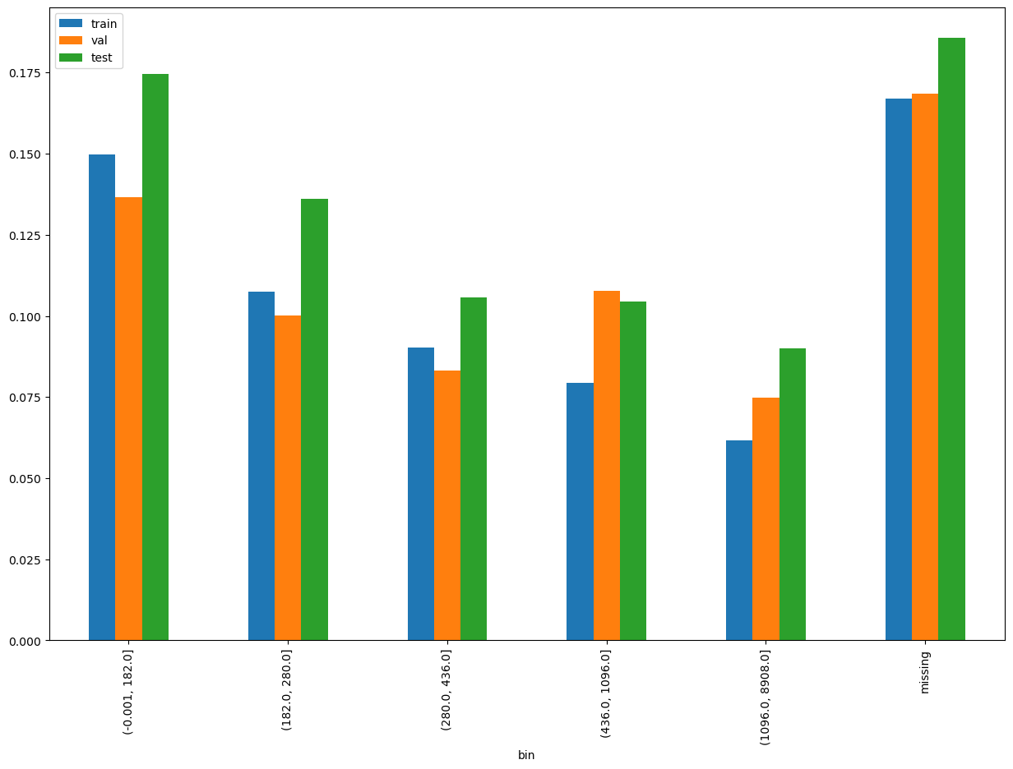
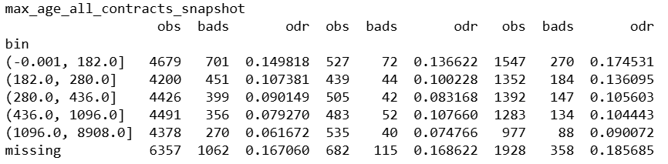
max_age_all_contracts_snapshot

Slide 10
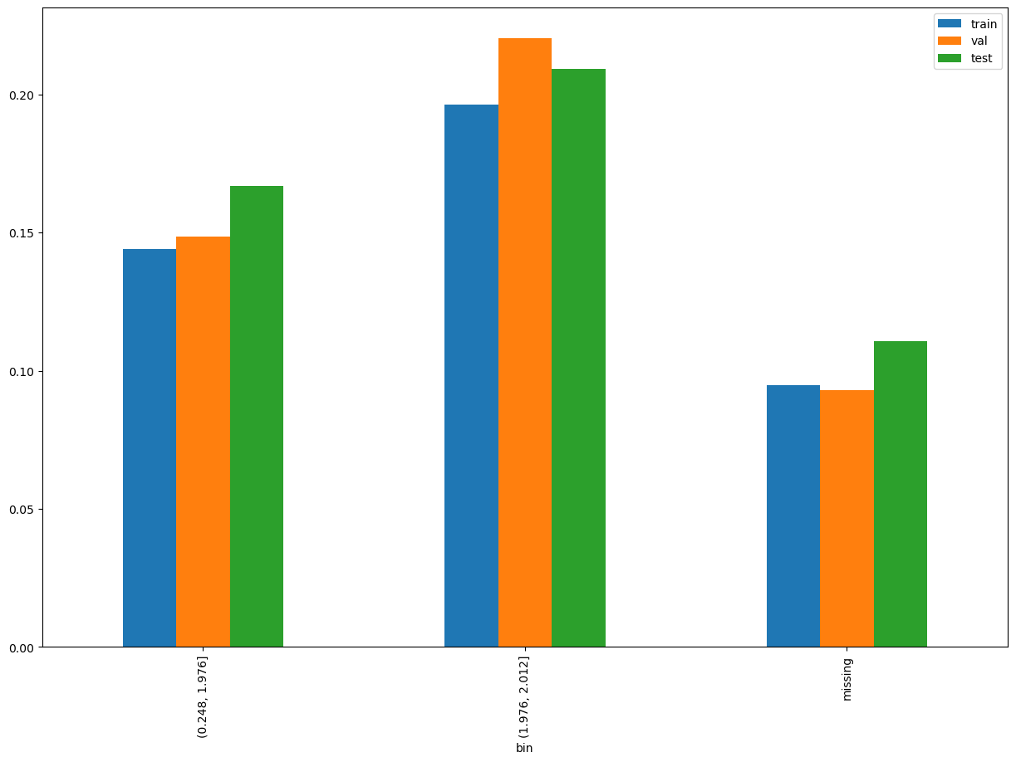
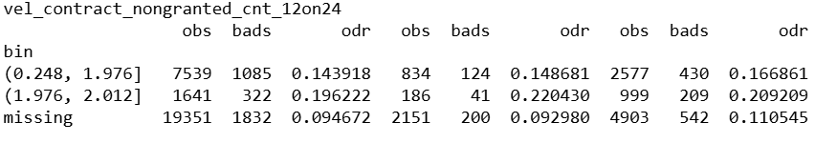
vel_contract_nongranted_cnt_12on24

Slide 11
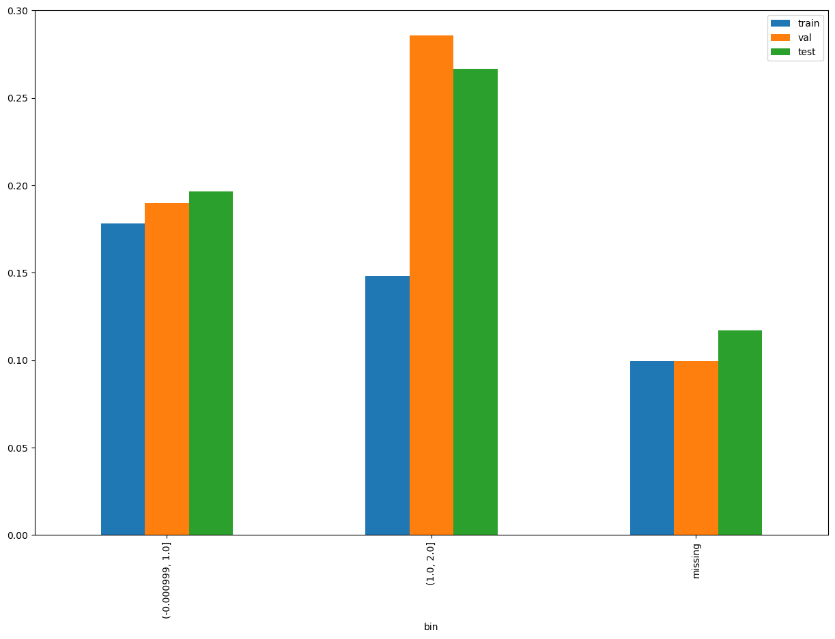
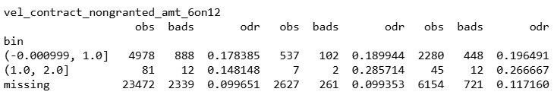
vel_contract_nongranted_amt_6on12

Slide 12
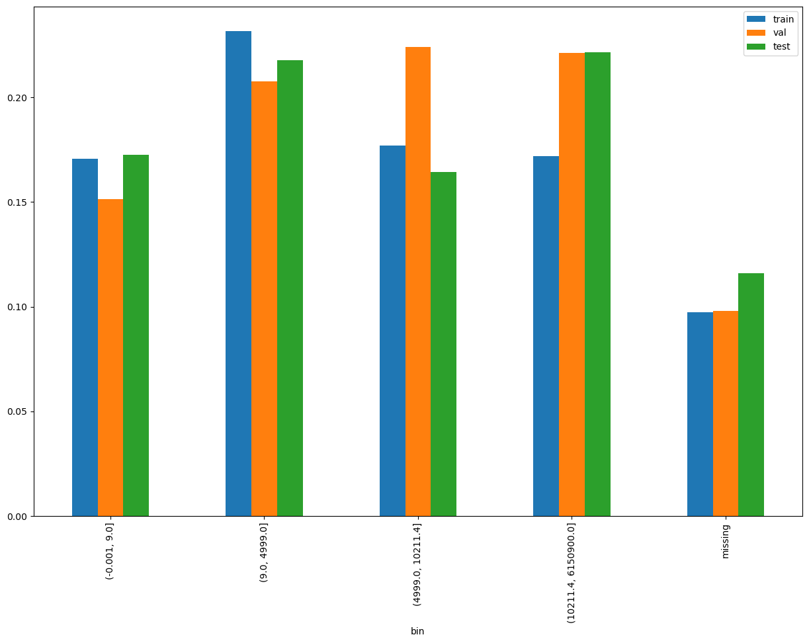
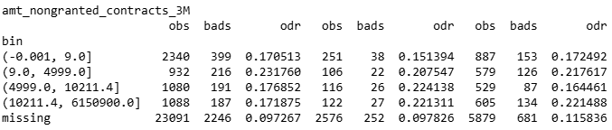
amt_nongranted_contracts_3M

Slide 13
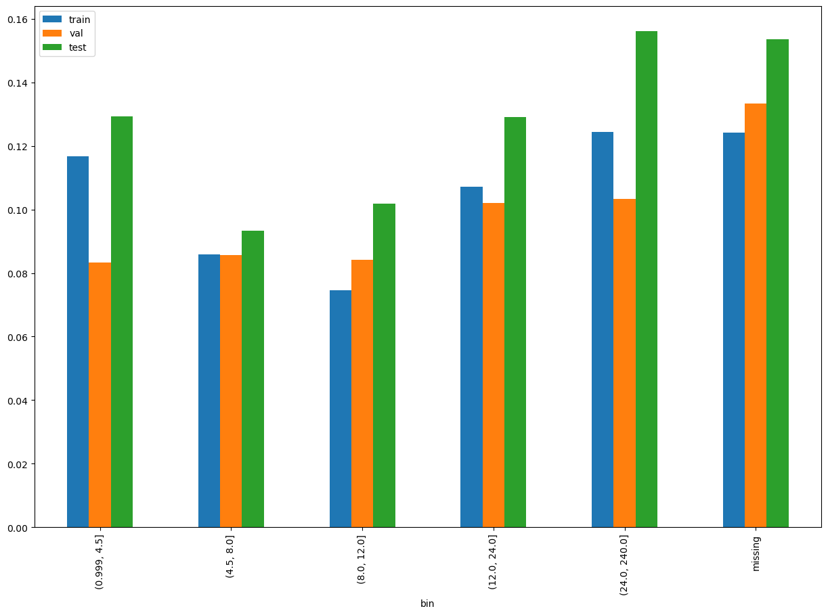
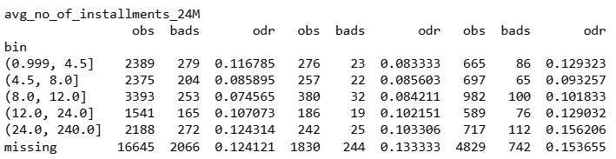
avg_no_of_installments_24M

Slide 14
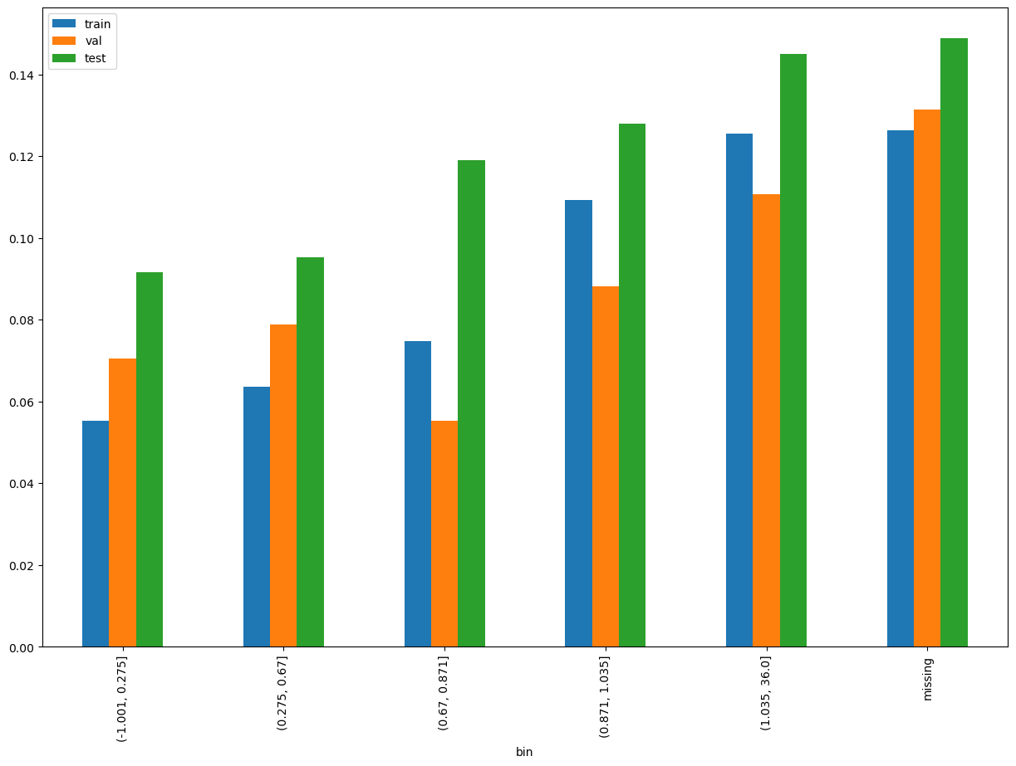
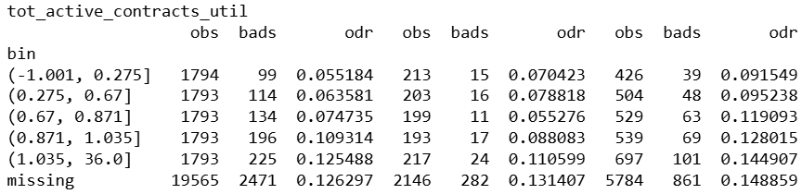
tot_active_contracts_util

Slide 15
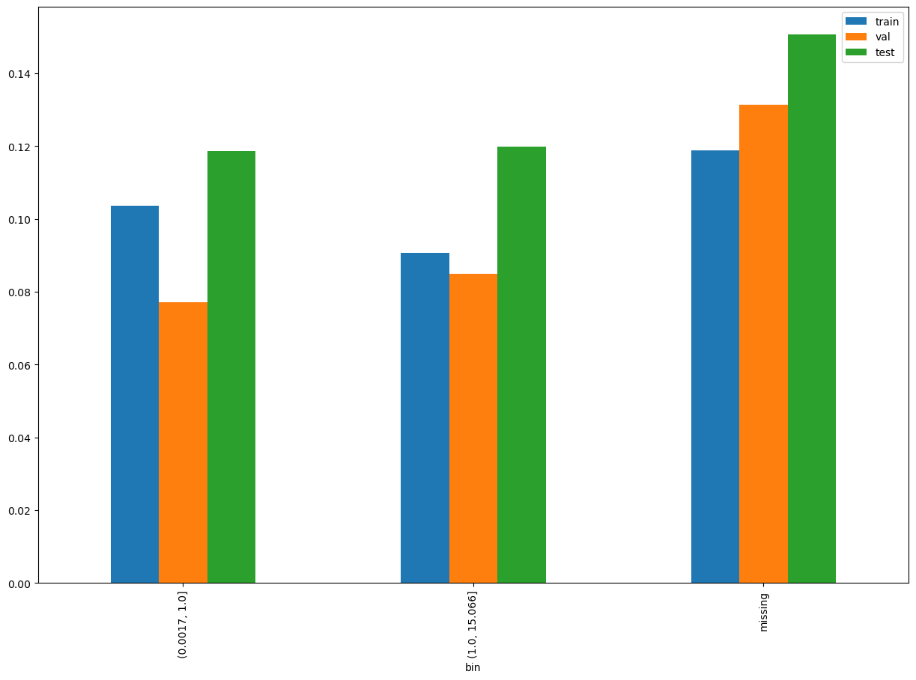
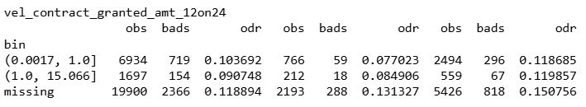
vel_contract_granted_amt_12on24

Slide 16
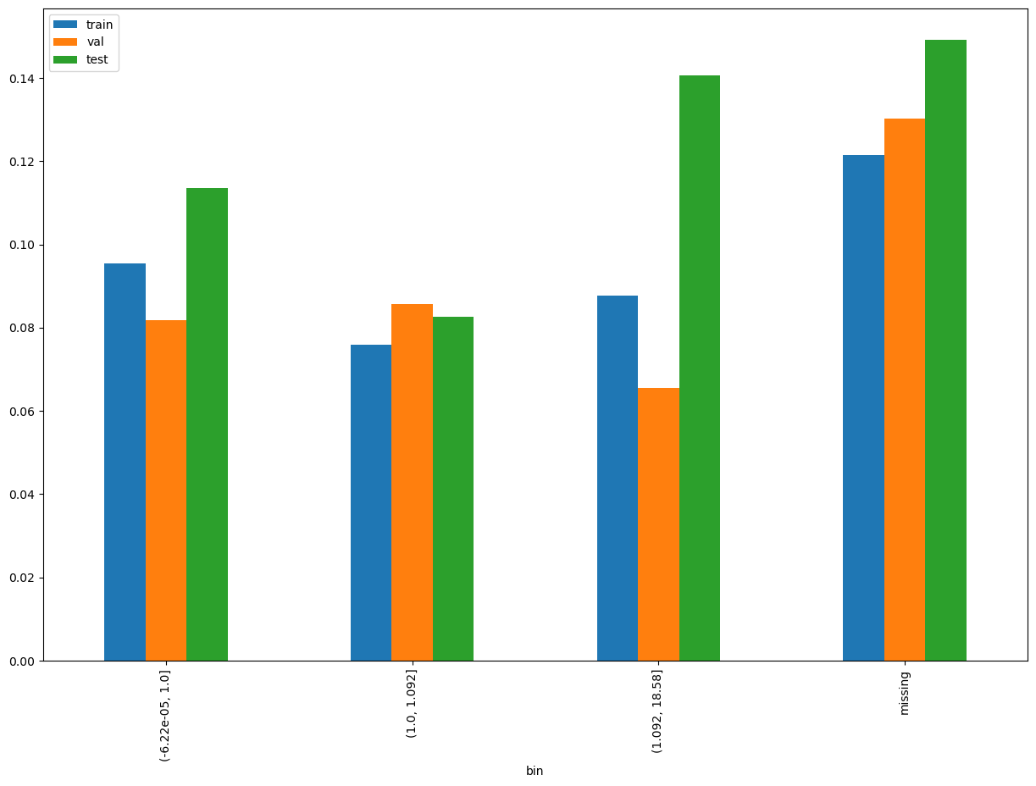
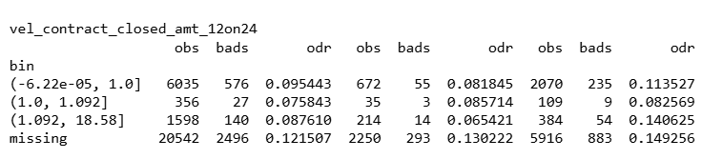
vel_contract_closed_amt_12on24

Slide 17
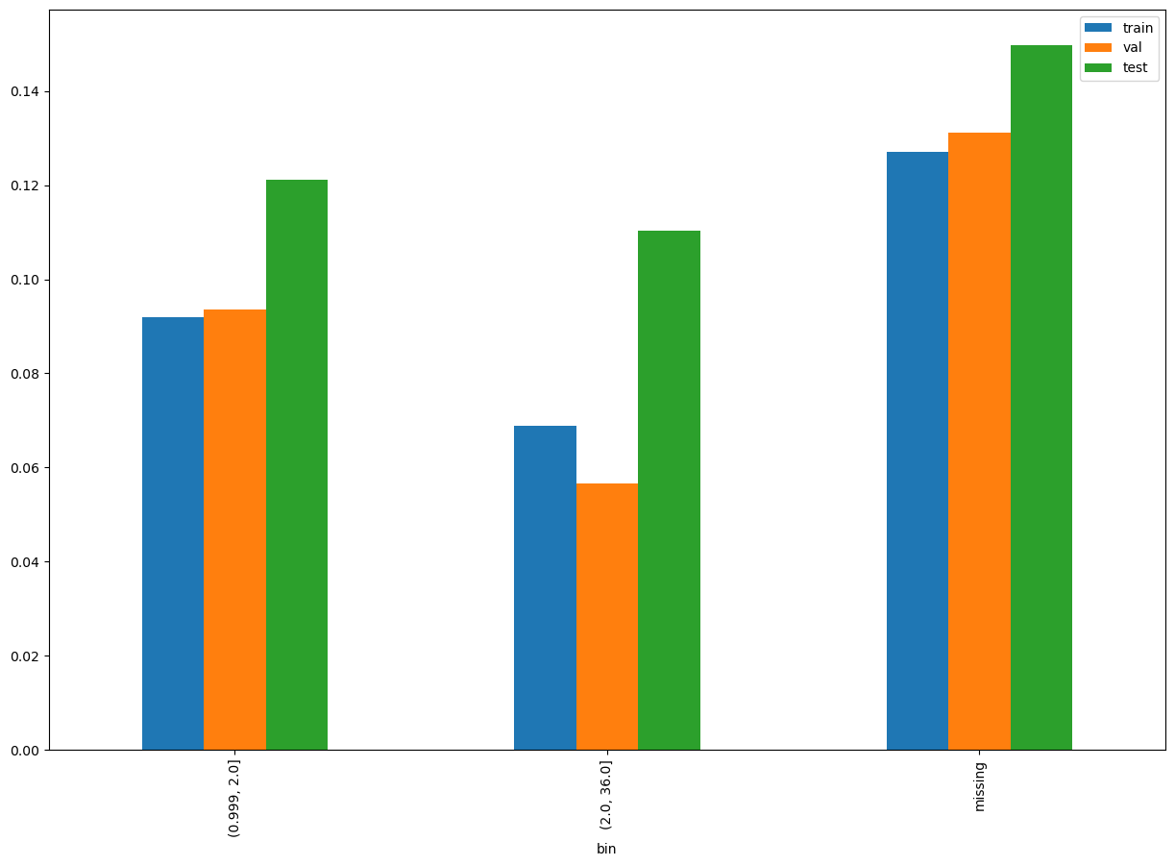
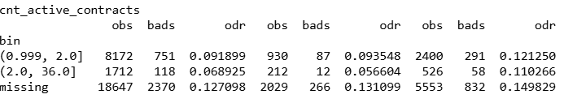
cnt_active_contracts

Slide 18
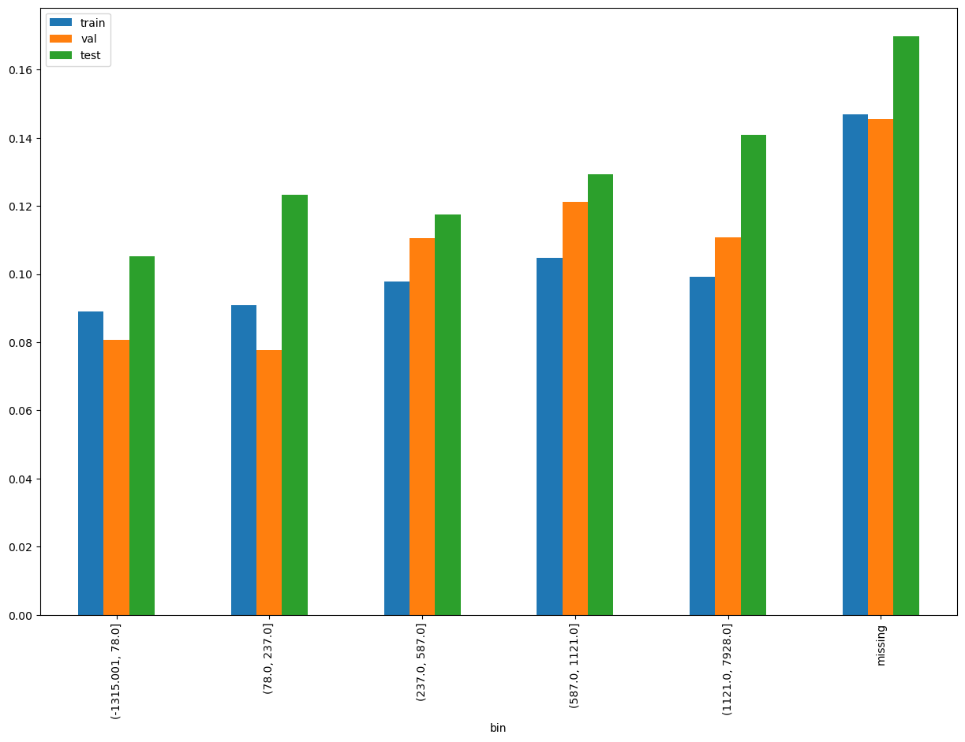
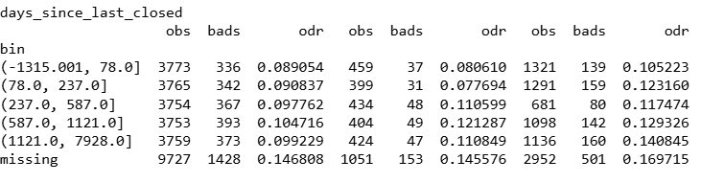
days_since_last_closed

Slide 19
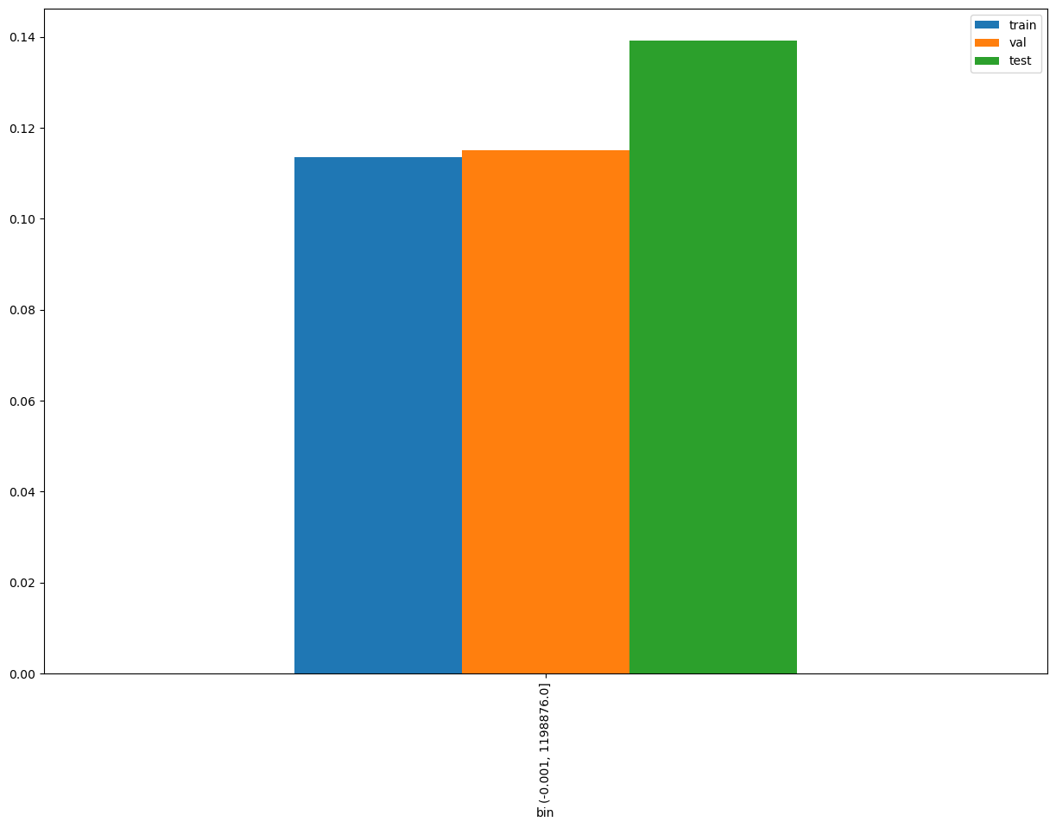

NonInstAvgCreditLimit

Slide 20
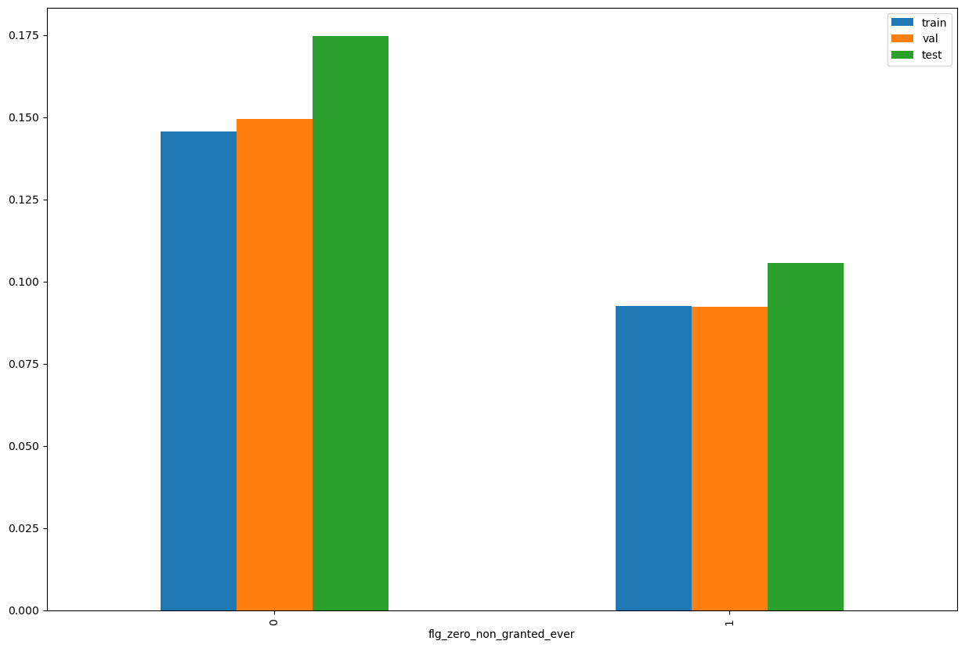
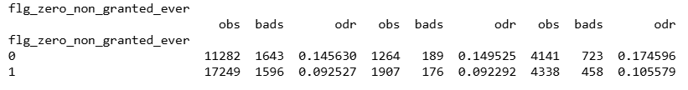
flg_zero_non_granted_ever

Slide 21
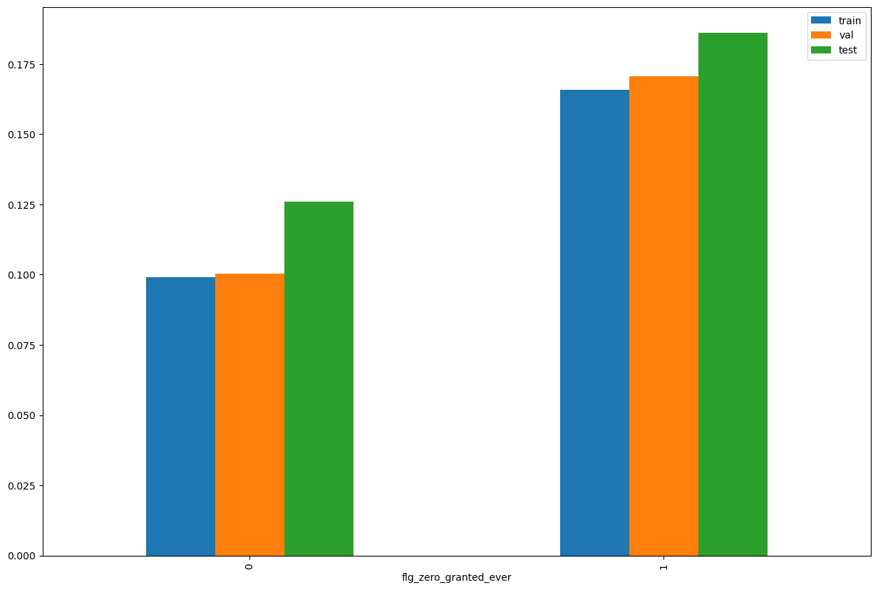
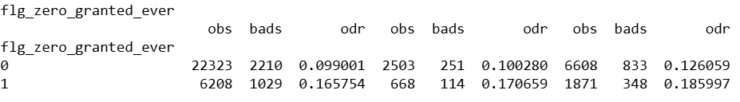
flg_zero_granted_ever

